Slide 1

Start-ups Failure
Prof. Mamoni Banerjee
Rejendra Mishra School of Engineering Entrepreneurship
IIT Kharagpur

Slide 2

What Made The 2 Drive To Co-found Quincy’s
Lack of work wear
Lack of variety of size
Lack of cost effective apparel
Lack of range of choice at various sizing option

Slide 3

What Was The Main Driving Gap They Focus In The Industry
The availability of budget friendly clothes along with the required fit and size range.
As lower budget doesn't came with the required feel and size and for that premium needs to be paid

Slide 4


Inspiration Of The Company Framework Was Based On
Bonobos and Warby Parker

Slide 5


What Was The Actually Framework Them Formed Form The Above Two
Online retailing to minimize the wholesale cost and cut down extra commission in between

Slide 6


What Were There Major Innovation That They Focused While Establishing The Company
Product Testing
Production, Distribution and sale
Seasonal Collection
Soft Launch
Marketing
Targeted Launch

Slide 7

What Point Do You Think They Innovated In Product Testing And How They Might Benefit.
Surveyed about people complain
Targeted colleges to understand basic need
Hosted trunk shows to showcase their design and concept
Got significant positive result regarding their sizing hypothesis
People were interested to purchase the dress
They even converted trunk attendee into their upfront customer
TO understand customization for a broader segment of women.

Slide 8

What Point Do You Think They Innovated In Production, Distribution And Sale And How They Might Benefit
Online marketing
Free shipping and return
Customised finalising of demand
Pre-form bulk manufacturing
direct-to customer relation
Trunk show in colleges
Understand customer demand more rapidly
Created a more robust customer relationship
Direct sale generating revenue without much finalizing process
Reduced the complexity of manufacturing customized clothes from scratch
Create a more quicker response for targeted customer segment

Slide 9

Now They Are Ready To Go

Slide 10


At The Time Of Starting The Production What Was The First Problem That They Tackled And How They Solved It
The lack of same fabric they used for trunk show
Sizing alteration
Higher bid cost
Unavailability of production scheduling
By establishment of relation with customer directly
Lack of production facilities

Slide 11


What Point Do You Think They Innovated In Seasonal Collection And How They Might Benefit
Targeted customer demand based on season
Customization target depending upon the segment of customer
Designing from scratch to understand and curate toward customer needs
Help in reducing process complexity as some customer focus on design and style rather than fit
Create a strong foundation for customer curated design
Segregation of customer based on individual segment requirement in order to cater

Slide 12


What Point Do You Think They Innovated In Soft Launch And How They Might Benefit
Launching of online marketing platform
Availability of collection in the online platform
Help people decide about the choice and purchase
People were able to gain trust due to versatility in purchase options

Slide 13

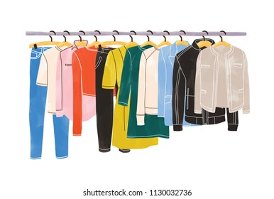
What Problem Do They Production House Faced During Sale And Manufacture Of Garment And How They Rectified It
Quality control and assurance was lacking as the product had quality defects that would render their product unstable
Hiring of quality control technical team to curate the need

Slide 14

What Point Do You Think They Innovated In Marketing And How They Might Benefit
Word to mouth approach
Social media
Trunk show
Referral
Showroom events
Conference advertisement
Catchy slogan
Challenging traditional purchase pattern
blog
Help reduce paid advertisement cost
Create more direct relation and revenue generation method
Impacted more on customer purchase pattern

Slide 15


Despite All These Innovation, Idea And Strategy Why Do The Startup Failed?
Value proposition and operation
Leadership team dynamics
Building the team
Managing investor
Going to the market

Slide 16

What Is a Value Proposition?
A value proposition is a statement that positions your company within your industry, and tells customers why they should invest in your product rather than your competitors’.

Slide 17
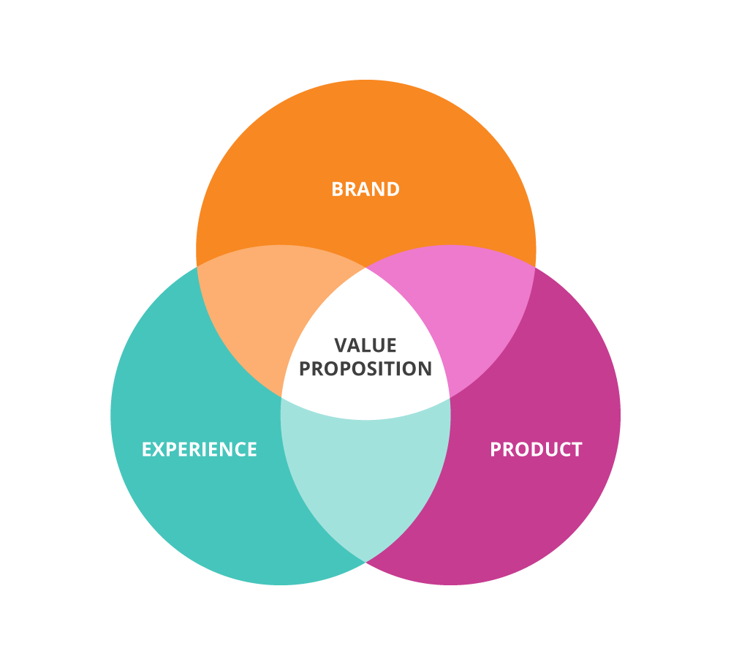
What went wrong in value proposition and operation
Operational complexity
Wider range of production that complicated the manufacturing process
Not perfecting singe fabric or pattern but customizing the whole lot of available fabric and pattern
Absence of beta testing phase
Complex integration of manufacturing facilities vertically

Slide 18
What is Leadership Dynamics ?
Leadership Dynamics is your strategic partner in personal and organizational training and development

Slide 19

What went wrong in leadership team dynamics
Lack of industrial experience
Absence of idea nurturing
Absence of clear defined role of co-founders
Lack of common vision and mission
Unalignment of ideas generation
Lack of external consultant to organise the stuff

Slide 20
What is Team building ?
Team Building is the process of turning a group of individual contributing employees into a cohesive team—a group of people organized to work together to meet the needs of their customers by accomplishing their purpose and goals.

Slide 21

What went wrong in Building the team
Started with family
Lack of industry experience lead to bad choice of people for the respective roles
Lack of interdimensional talks
Lack of feedback within the employee
Absence of supervision

Slide 22
What Is an Investor?
An investor is any person or other entity (such as a firm or mutual fund) who commits capital with the expectation of receiving financial returns.

Slide 23

What Went Wrong In Managing Investors
Lack of industry experience costed relation with investors
Uncleared strategic and operational goal led to unprecedented failure in relation
Incorrect investor choice
Lack of investor understanding
Lack of fund raised leading to operational constrains

Slide 24
What is Market ?
A market is defined as the sum total of all the buyers and sellers in the area or region under consideration.

Slide 25

What Went Wrong In Going To Market
Lack of proper research on consumer requirements and hurried retailing
Unclear target audience and place
Lack of beta phase/testing phase
Lack of market understanding and creation of strategy accordingly
Focused on only customer demand rather than profit statements

Slide 26


So, How do you feel you could improve the above given mistakes and what were yours's suggestion if you would have been in this position……………………….?

Slide 27


